Slide 1
AI for Noughts and Crosses
Henry Senior

Slide 2
Things to Research
Appropriate Programming Styles
Appropriate Programming Languages
Search Algorithms
Path Finding Algorithm
Minimax

Slide 3

Notable Research Sources
AI: A Modern Approach
AI Application Programming
Microsoft Developer Network
Stack Overflow (...a programmers best friend)

Slide 4
Minimax
John Von-Neumann
Game Theory and the MaxiMini Principle
Search Algorithm with limited search space
Score possible moves

Slide 5
What I learnt
Search Algorithms
Functional Programming
More features of C#
LaTeX (Lay•Tec)
How to write an academic paper

Slide 6
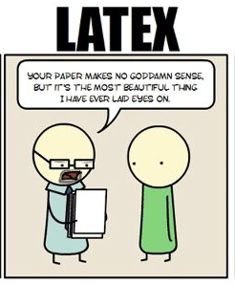

Slide 7
Real World Applications
AI
Siri/Google Now/Cortana
Search Engines (Google/Yahoo/Bing)
Game Theory is EVERYWHERE
Used to trick Hitler in World War 2
Traffic Jams
Notes:
Braess' paradox: It was exposed in 1968 by mathematician Dietrich Braess who noticed that adding a road to a congested road traffic network could increase overall journey time, and has been used to explain instances of improved traffic flow when existing major roads are closed. The paradox may have analogues in electrical power grids and biological systems. It has been suggested that, in theory, the improvement of a malfunctioning network could be accomplished by removing certain parts of it.

Slide 8
Demonstration
Let’s hope this works...

Slide 9
Any Questions?

